Slide 1
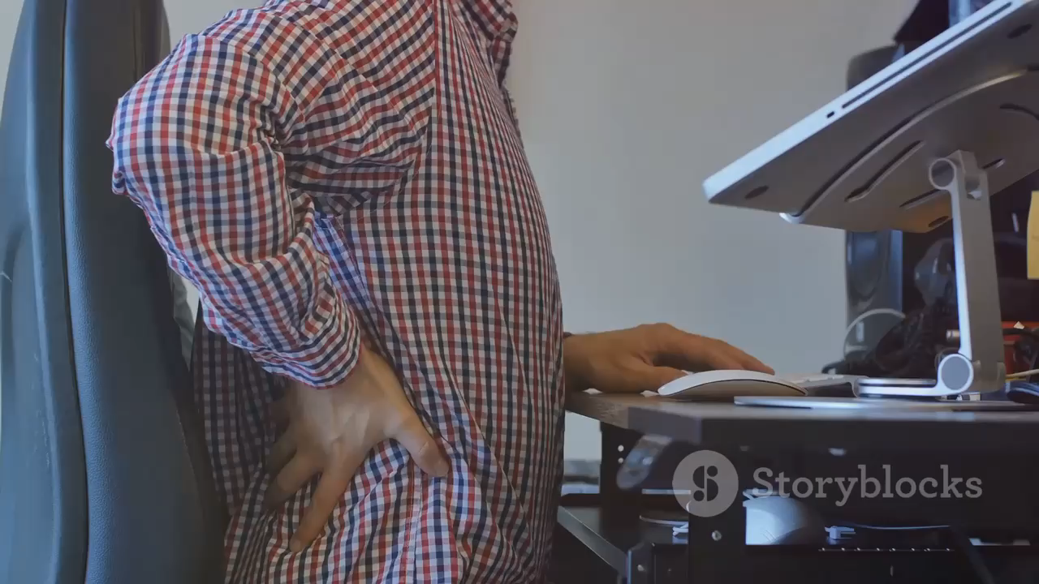

Slide 2
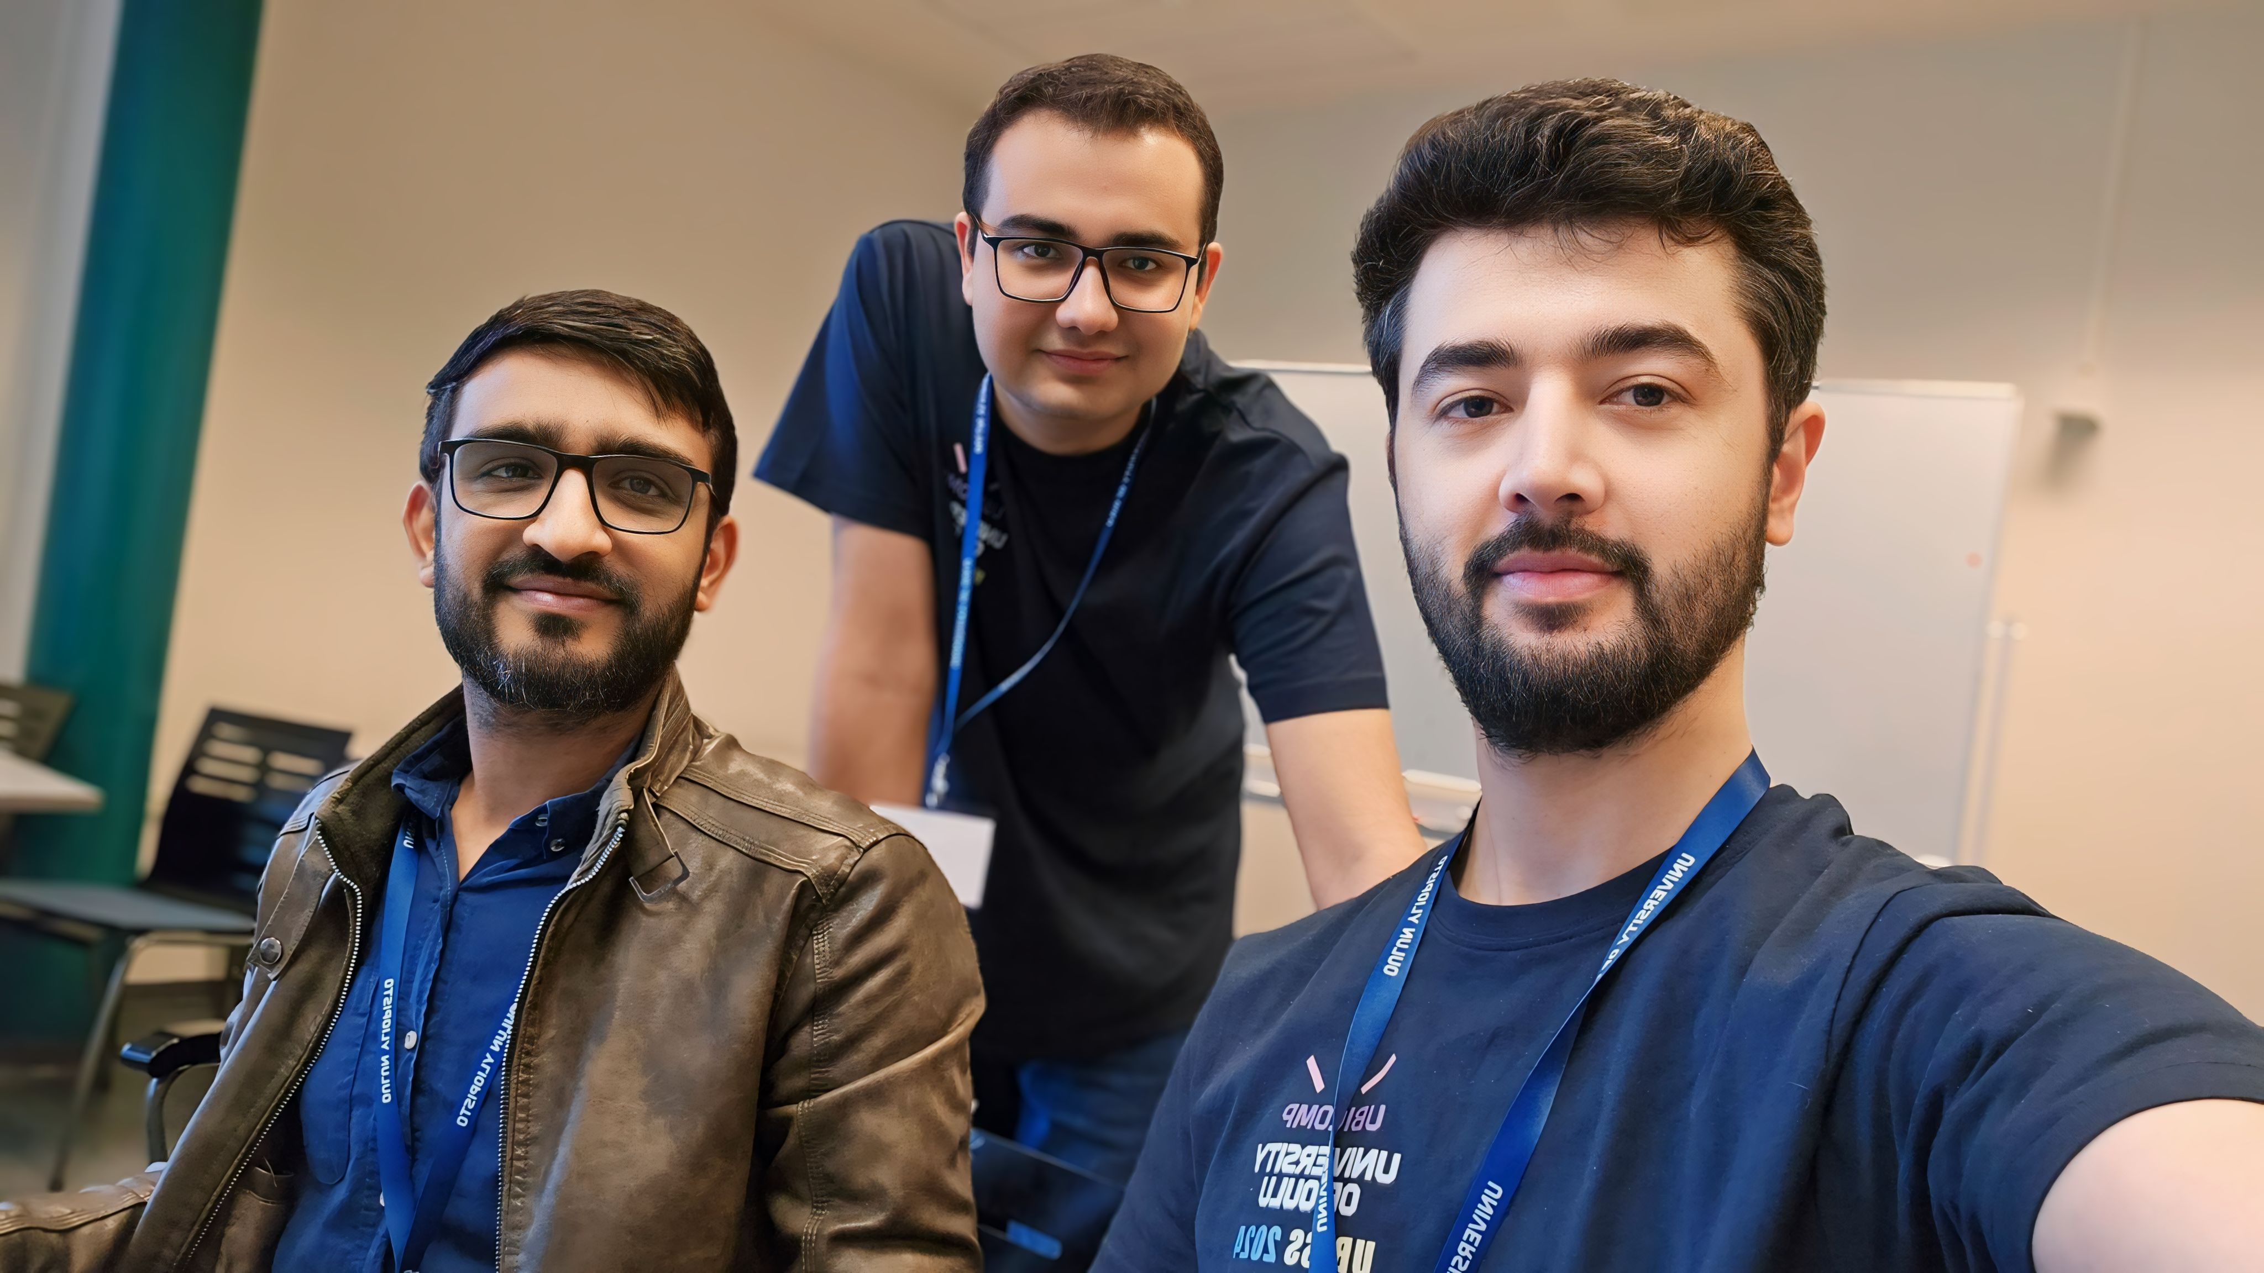
Meet our team
Ijlal Khan
Muhammad Talha Arshad
Toseef Ahmed

Slide 3
Technical Description
Hardware
Arduino Nano RP2040
Ultrasonic Sensor HC-SR04
Flex Sensor 2.2 Inch
Buzzer
Software
Thony IDE (Micropython)
python 3.8

Slide 4
Dataset Description
02 Ultrasonic sensors
01 Flex Sensor
1- Correct Posture
User sits on the chair with correct posture, and we have gathered 300 values as a dataset.
2- Leaning Forward
User sits leaning forward with different angles and collected 300 values as a dataset.
3- Leaning Backward
User sits leaning backward with different angles and we have collected 300 values as a dataset
4- Not on Correct position
User sit on not usual positions making difference in flex sensor normal readings

Slide 5
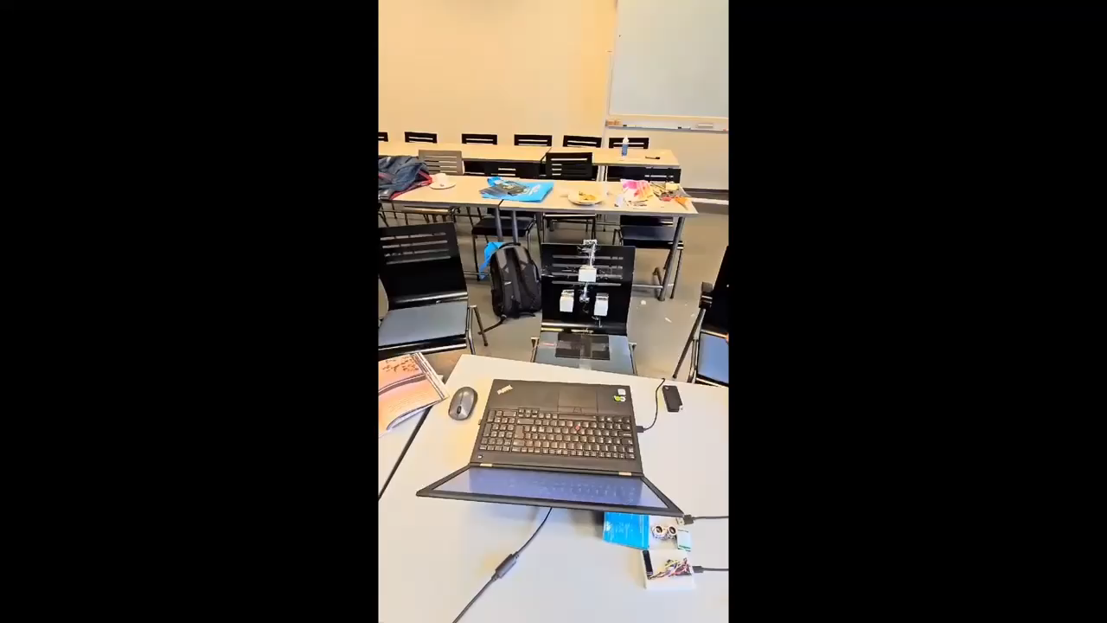

Slide 6
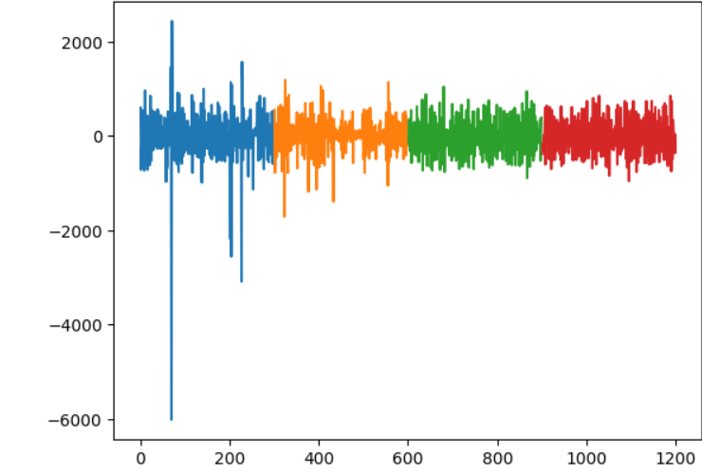
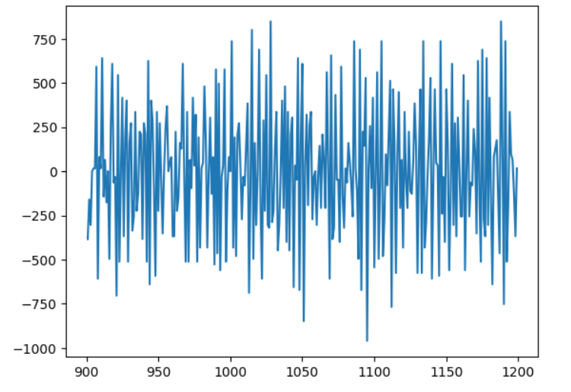
Ultrasonic Sensors
Flex Sensor

Slide 7
ML Model Approach + Evaluation
Data Preparation
Pre-processed the data from sensors to transform it for the model.
2. Splitting Data
70 – 30 ratio for training and testing data, respectively.
3. Model Building
Defined the number of trees and their depths.
Building the model
Built for Micropython
5. Evaluation:
Achieved 90% accuracy.

Slide 8



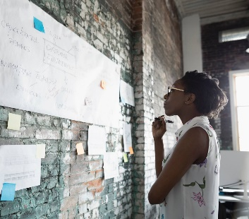
Thank you

